Slide 1

Detection Methods for Software Defined Network Intrusions
SRM INSTITUTE OF SCIENCE AND TECHNOLOGY
SCHOOL OF COMPUTING
DEPARTMENT OF DSBS
18CSP462L – PROJECT EVALUATION-II
GUIDE DETAILS:
Dr.K.Priyadarsini
Assistant Professor
Department of DSBS:
Team Members:
Sigirala Naveen
(RA2011042010086)
P Indivar
(RA2011042010107)

Slide 2

TABLE OF CONTENTS:
Abstract
Problem Identification and Description
Literature Survey
Requirement Specification
Existing and Proposed System
Methodology
Model Diagrams
Modules
Performance Measures
Results and Analysis
Project Demo
Conclusion
Conference Paper Publication Details

Slide 3
ABSTRACT
Intrusion detection systems (IDSs) are currently drawing a great amount of interest as a key part of system defense. IDSs collect network traffic information from some point on the network or computer system and then use this information to secure the network.
To distinguish the activities of the network traffic as intrusion and normal is very difficult and consumes a lot of time.
An analyst must review all the data that large and wide to find the sequence of intrusion on the network connection. Therefore, it needs a way that can detect network intrusion to reflect the current network traffics.
In this study, a novel method to find intrusion characteristic for IDS using genetic algorithm machine learning of data mining technique was proposed. Method used for generation of rules is classification by genetic algorithm of decision tree.
These rules can be used to determine the intrusion characteristics then to implement in the genetic algorithm as prevention
Due to this, besides detecting the existence of intrusion, we also can also execute denial of intrusion as prevention.
DEPARTMENT OF COMPUTER SCIENCE AND ENGINEERING

Slide 4
PROBLEM IDENTIFICATION AND DESCRIPTION
With the growing rate of interconnections among computer systems, network security is becoming a major challenge. In order to meet this challenge, Intrusion Detection Systems (IDS) are being designed to protect the availability, confidentiality and integrity of critical networked information systems. Automated detection and immediate reporting of intrusion events are required in order to provide a timely response to attacks.
Early in the research into IDS, two major approaches known as anomaly detection and signature detection were arrived at.
In this project network-based anomaly detection method for detecting Denial of Service and network Probe attacks is done.
In anomaly detection, the normal behavior of the system is modeled. Incoming patterns that deviate substantially from normal behavior are labeled as attacks.
DEPARTMENT OF COMPUTER SCIENCE AND ENGINEERING

Slide 5
LITERATURE SURVEY
 | TITLE | AUTHOR | OBJECTIVE | METHODOLOGY | RESULT | LIMITATION
1 | Intrusion Detection System for Wireless Networks 2021 | Baimukashev Rashid; Kamalkhan Artykbayev; Kazybek Adam; Begenov Mels | To enhance network security in wireless networks by designing and evaluating an intrusion detection system. Investigate the performance of deep learning approaches (CNN, RNN, LSTM) and traditional machine learning algorithms (SVM, Random Forest, XGBoost) for intrusion detection in wireless networks. | Utilizes deep learning approaches including Convolutional Neural Networks (CNN), Recurrent Neural Networks (RNN), and Long Short-Term Memory (LSTM). - Employs traditional machine learning algorithms such as Support Vector Machines (SVM), Random Forest, and XGBoost. - Evaluation conducted using the NSL-KDD dataset. | 1. Achieved near state-of-the-art performance in detecting network attacks on the NSL-KDD dataset, indicating the effectiveness of the intrusion detection system. 2. Deep learning models (CNN, RNN, LSTM) demonstrated their capability to effectively detect network attacks, sometimes outperforming traditional machine learning methods. | 1. Focus primarily on the NSL-KDD dataset, which may not fully represent all network attack scenarios. Performance might differ in different datasets or real-world environments. 2. Deep learning models may require significant computational resources and data, impacting scalability.
DEPARTMENT OF COMPUTER SCIENCE AND ENGINEERING

Slide 6
LITERATURE SURVEY
 | TITLE | AUTHOR | OBJECTIVE | METHODOLOGY | RESULT | LIMITATION
2 | A Deep Learning Approach for Intrusion Detection 2021 | Roua Dhahbi; Farah Jemili | To enhance intrusion detection systems by leveraging cloud computing and integrating big data and deep learning techniques. The goal is to achieve early detection of various attacks in cyberspace with high accuracy and low training time. | - Utilizes cloud computing, specifically Microsoft Azure Cloud, for processing power and storage capabilities. - Integrates big data handling and analysis. - Implements a Convolutional Neural Network (CNN–IDS) using the Keras Deep Learning Library. - Deploys the system with the distributed computing environment Apache Spark. - Evaluates performance using the CSE-CIC-IDS2018 dataset for binary and multiclass classification. | - Demonstrates the effectiveness of integrating deep learning techniques and Apache Spark for intrusion detection. - Achieves high performance in detecting various attacks early. | - The authors do not specify their names. - Limited information is provided regarding the implementation details, making it challenging to replicate the system. - The focus is primarily on performance evaluation, lacking an in-depth discussion of the system's architecture and deployment challenges. - Specific performance metrics and results are not mentioned in the provided text.
DEPARTMENT OF COMPUTER SCIENCE AND ENGINEERING

Slide 7
LITERATURE SURVEY
 | TITLE | AUTHOR | OBJECTIVE | METHODOLOGY | RESULT | LIMITATION
 | A Simple Deep Learning Approach for Intrusion Detection System 2021 | Atsushi Takeda; Daichi Nagasawa | To develop a deep learning-based intrusion detection system (IDS) for detecting U2R and R2L attacks in cloud services with higher accuracy compared to existing methods. The approach aims to achieve this without requiring domain knowledge or extensive feature engineering. | Utilizes deep learning techniques, including Convolutional Neural Networks (CNNs). - Applies over-sampling, under-sampling, and data augmentation to address class imbalance. - Avoids the need for domain knowledge or complex feature engineering. - Evaluates the proposed method using the KDD Cup 99 Dataset. | The proposed deep learning-based IDS outperforms previous methods in the detection of U2R and R2L attacks in cloud services. - Achieves higher accuracy without the need for domain-specific knowledge. | The authors' names are not provided. - Limited information is available regarding the implementation details and specifics of the deep learning model used. - The paper focuses primarily on performance results, lacking in-depth discussions of the model's architecture or potential challenges. - Specific performance metrics and detailed results are not mentioned in the provided text.
DEPARTMENT OF COMPUTER SCIENCE AND ENGINEERING

Slide 8
REQUIREMENT SPECIFICATIONS
HARDWARE REQUIREMENTS
SOFTWARE REQUIREMENTS
Basic Computer Setup
Wi-Fi Connection Setup
Operating System: Windows 7 above
Language: Python
Tool: PyCharm
Library:Python (version 3.6.5)
Keras (version 2.1.6)
TensorFlow (version 1.7.0)
DEPARTMENT OF COMPUTER SCIENCE AND ENGINEERING

Slide 9
EXISTING SYSTEM
Artificial Neural Network (ANN)
K-Mean Clustering
Fast Learning Network
Ensemble Methods.
DEPARTMENT OF COMPUTER SCIENCE AND ENGINEERING

Slide 10
PROPOSED SYSTEM
Genetic algorithm is one of the most commonly used machine learning approach in the field of intrusion detection, which consists of its natural selection.
Decision node represents to testing a single attribute of the given instances whereas the leaf node presents the idea about whether the output of a classifier falls in to either normal or intrusion (any of the possible attacks) category during the classification phase.
A novel method to find intrusion characteristic for IDS using decision tree machine learning of data mining technique was proposed.
Method used for generation of rules is classification by genetic algorithm of decision tree.
Behavior of the attacker is obtained from the historic data of kdd dataset.
Finding are normal Probe and Dos attack .
DEPARTMENT OF COMPUTER SCIENCE AND ENGINEERING

Slide 11
METHODOLOGY
The methodology for intrusion detection using genetic algorithms (GA) and decision trees (DT) typically involves the following steps:
Data collection: The first step in the methodology is to collect data about the network traffic and system logs. This data will be used to train and test the intrusion detection system.
Data pre-processing: The collected data needs to be pre-processed to remove noise, filter out irrelevant information, and transform the data into a suitable format for analysis.
Feature selection: The next step is to select a set of features that are most relevant for intrusion detection. This can be done using various feature selection techniques, such as mutual information, chi-square, or correlation-based methods.
GA-based feature selection: The selected features are then used as input for a GA-based feature selection algorithm. The GA algorithm searches for an optimal subset of features that maximize the classification accuracy of the DT classifier.

Slide 12
DT-based classification: Once the optimal subset of features is selected, a DT classifier is trained using the selected features. The DT classifier uses the decision tree algorithm to classify network traffic and system logs as normal or anomalous.
Evaluation: The performance of the intrusion detection system is evaluated using various metrics, such as accuracy, precision, recall, and F1 score. The evaluation is typically done using a separate testing dataset.
Detection: Using GUI we can detect both probe as well as DOS attack

Slide 13
BLOCK DIAGRAM
Training Phase
GA to optimize
Decision tree
IDS learning
Data preprocessing – Encoding, normalization
NSL-KDD Data Set
Testing phase
Dos
Performance detection
Intrusion classification
Probe
DEPARTMENT OF COMPUTER SCIENCE AND ENGINEERING

Slide 14
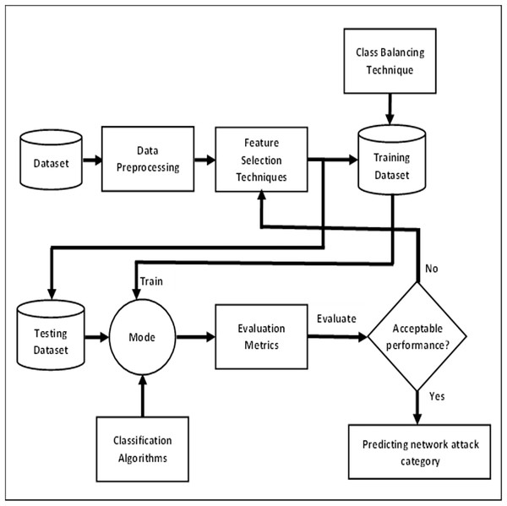
DATA FLOW DIAGRAM
DEPARTMENT OF COMPUTER SCIENCE AND ENGINEERING
14

Slide 15
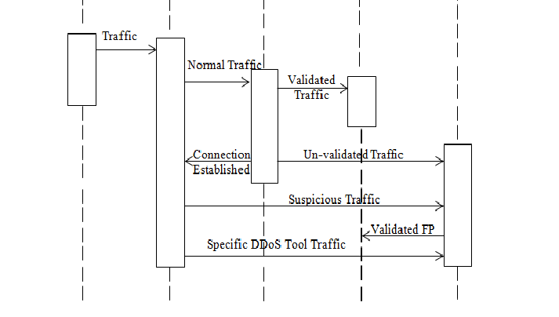
SEQUENCE DIAGRAM
15

Slide 16
MODULES
DATASET COLLECTION- NSL KDD
PREPROCESSING
MODEL TRAINING
GENETIC ALGORITHM AND DECISION TREE
MODEL TESTING
PREDICTION

Slide 17
PERFORMANCE MEASURES
True Positive Rate: True Positive Rate (TPR) in IDS measures the proportion of actual attacks that are correctly identified by the system.
False Positive Rate: False Positive Rate (FPR) in IDS measures the proportion of non-attacks incorrectly classified as attacks by the system.
Accuracy: Accuracy in IDS is the proportion of correctly classified instances (both attacks and non-attacks) out of the total instances.
Precision: Precision in IDS measures the proportion of correctly identified attacks among all instances classified as attacks.
Recall: Recall in IDS measures the proportion of actual attacks that are correctly identified by the system, indicating the system's ability to detect intrusions.
F1-score: F1 score in IDS is the harmonic mean of precision and recall, providing a balance between the two metrics for assessing the system's performance.

Slide 18
RESULTS AND ANALYSIS
By employing a combination of genetic algorithms (GA) and decision trees (DT) for intrusion detection systems (IDS), we obtained improved detection rates, reduced false alarms, and enhanced interpretability through feature selection and rule extraction. These systems typically demonstrate better performance in identifying attacks while minimizing false positives compared to traditional methods.

Slide 19
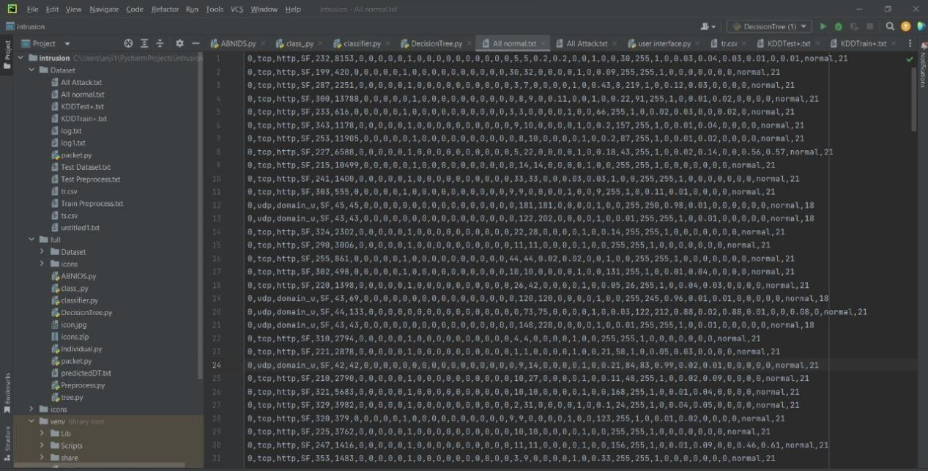
PROJECT DEMO
Dataset Collection
DEPARTMENT OF COMPUTER SCIENCE AND ENGINEERING

Slide 20
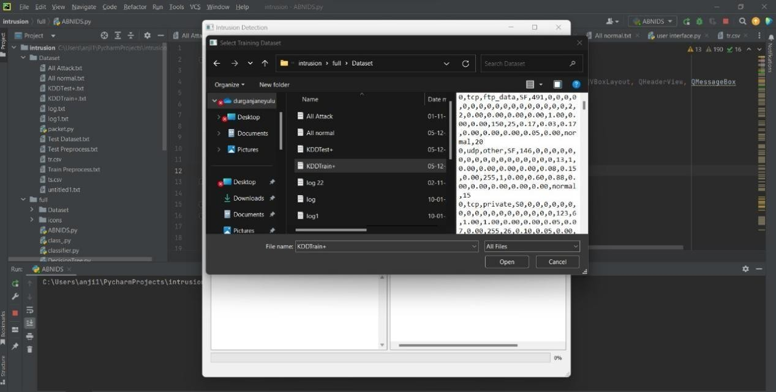
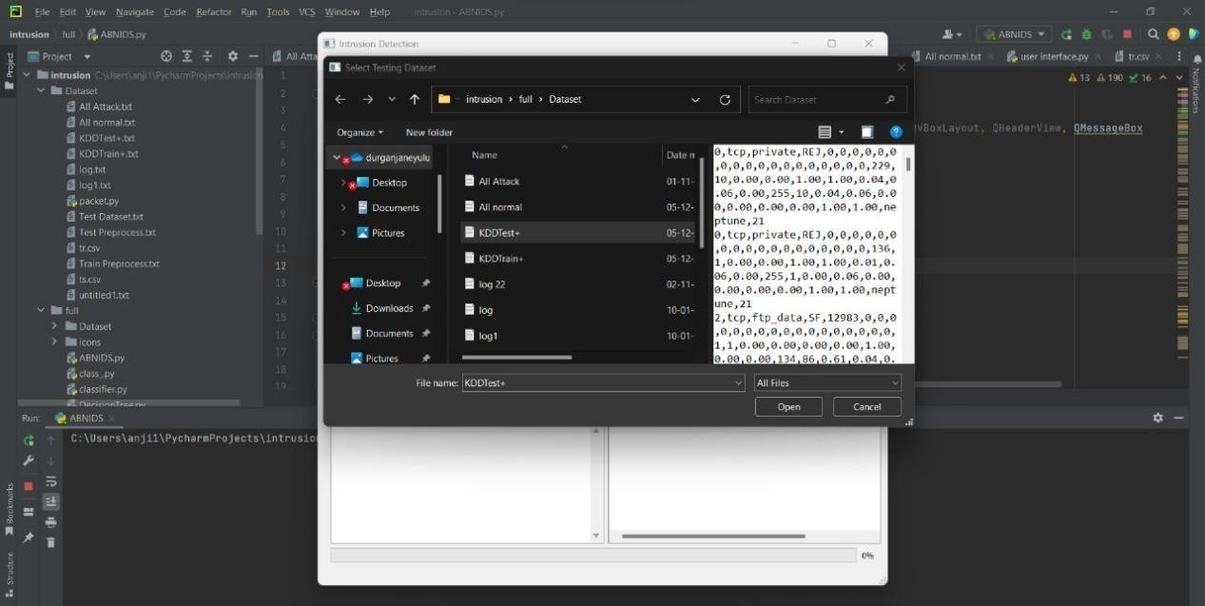
RESULT DEMO
Train and Test Data Selection
DEPARTMENT OF COMPUTER SCIENCE AND ENGINEERING

Slide 21
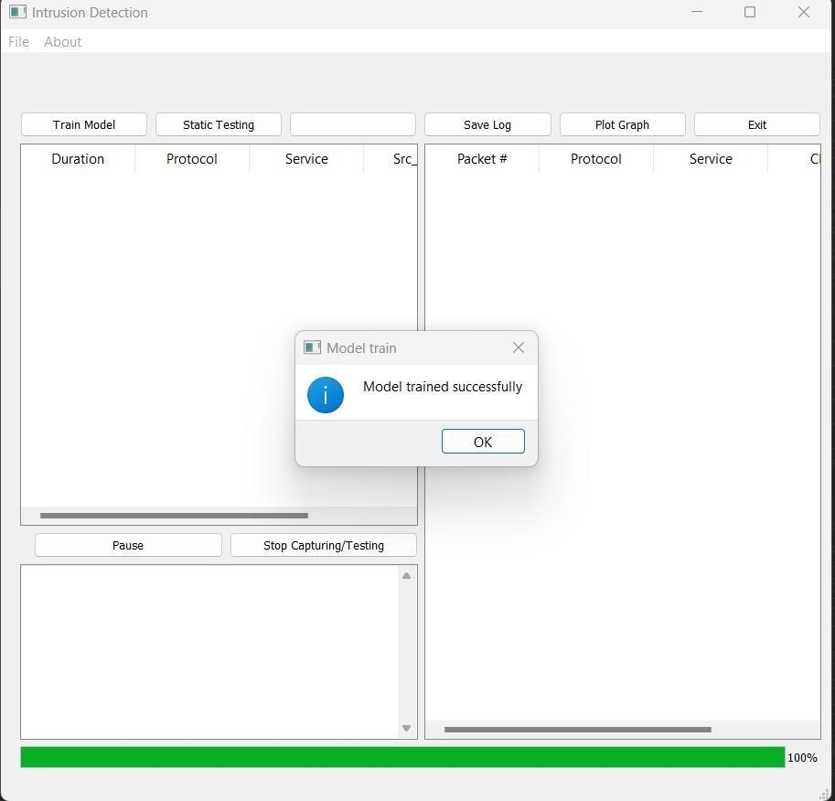
RESULT DEMO
Model Training
DEPARTMENT OF COMPUTER SCIENCE AND ENGINEERING

Slide 22
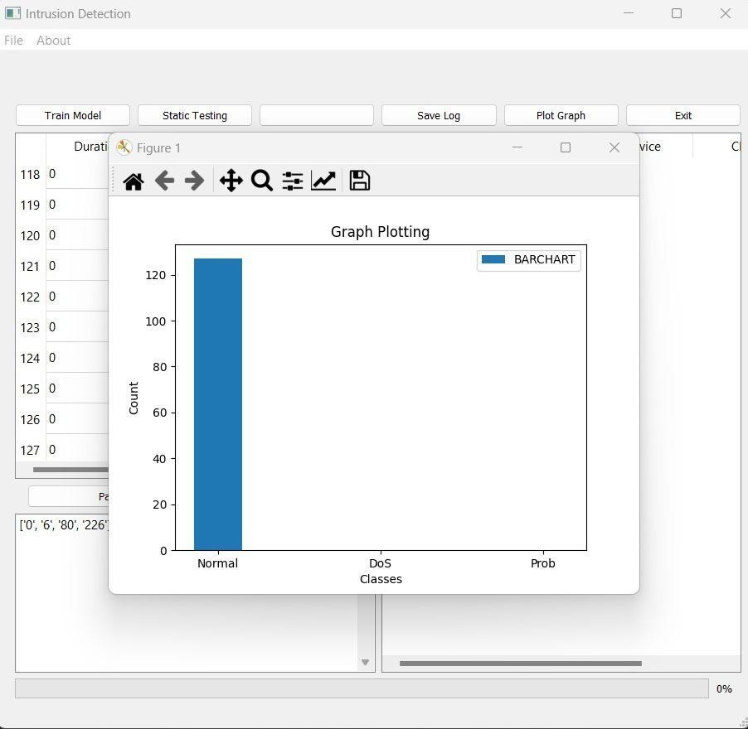
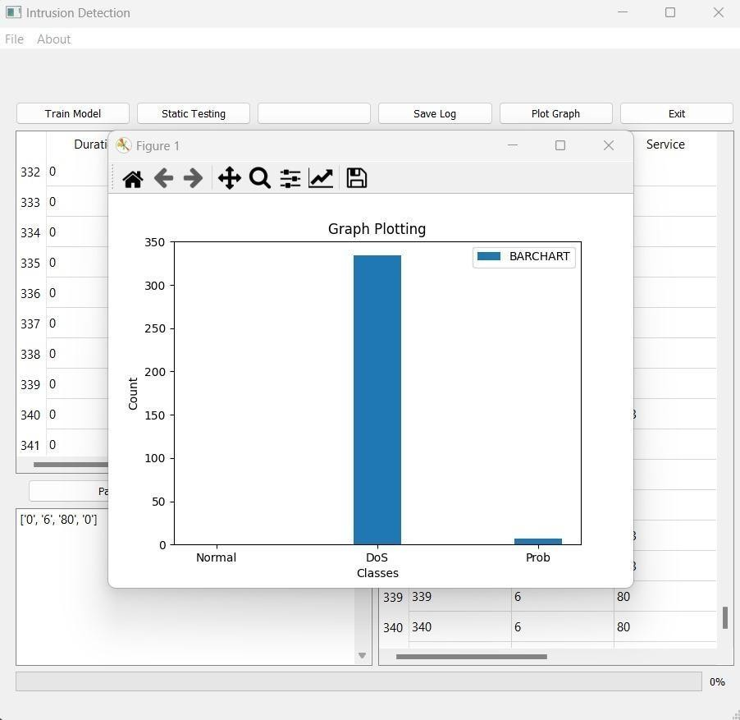
RESULT DEMO
Normal and Attack graph plots
DEPARTMENT OF COMPUTER SCIENCE AND ENGINEERING

Slide 23
CONCLUSION:
In this project a genetic algorithm along with decision tree approach is deployed to intrusion detection. Software implementation of the proposed approach is presented. Genetic algorithm was employed to generate classification rules for intrusion detection while principal component analysis was used to identify the key features of network connections.
GA-approach, with the appropriate and simple representation of the rules and effective fitness functions that can be applied, is easy to carry out and maintain. Moreover, the system is flexible enough to be used in different application environments, if the proper attack taxonomy and the proper training dataset exist. The classification of attacks is not important in intrusion detection, given the fact that the goal of intrusion detection is detecting attacks in real time so they could be retained before bringing about any damage.
High attack detection rate and low false-positive rate are the advantages of using this technique to intrusion detection without using any complementary technique that is commonly used with other soft-computing techniques. The system uses only three features of the network connections maintaining high detection rates, so it can perform intrusion detection process faster and could be applied to high speed networks.

Slide 24
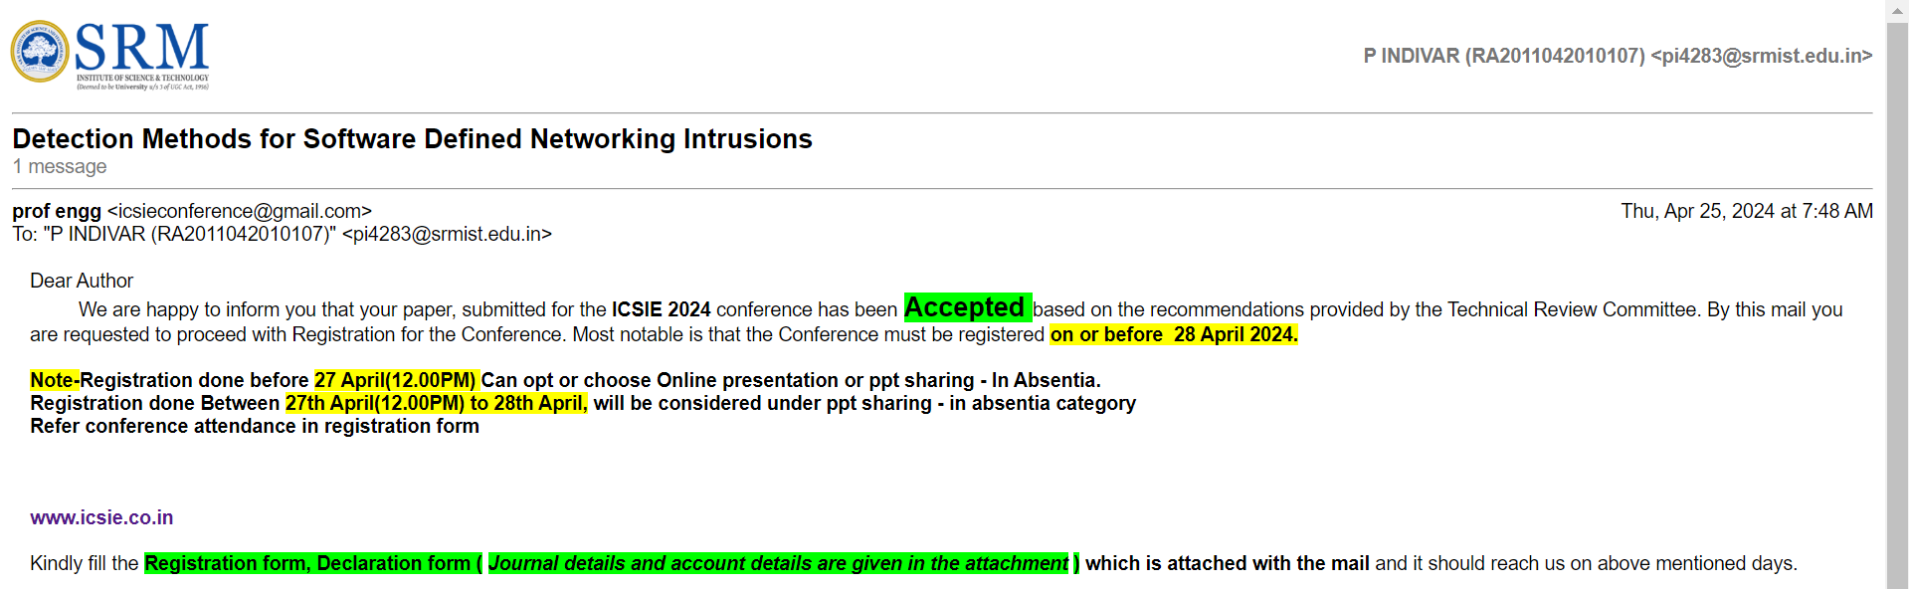
CONFERENCE PAPER PUBLICATION DETAILS

Slide 25
THANK YOU
DEPARTMENT OF COMPUTER SCIENCE AND ENGINEERING

